Slide 1
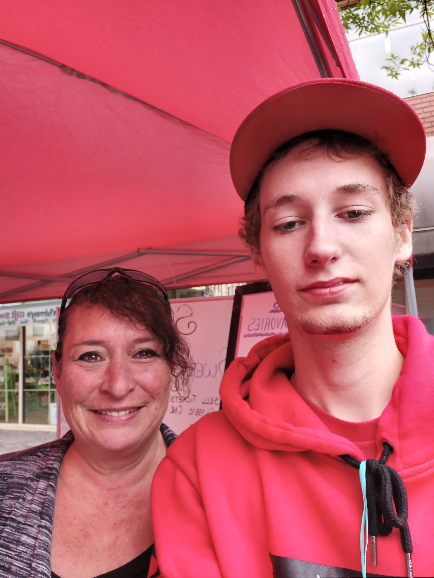
Susan Sweet & Savories
By: Xavier Levy
grappamanager@gmail.com

Slide 2
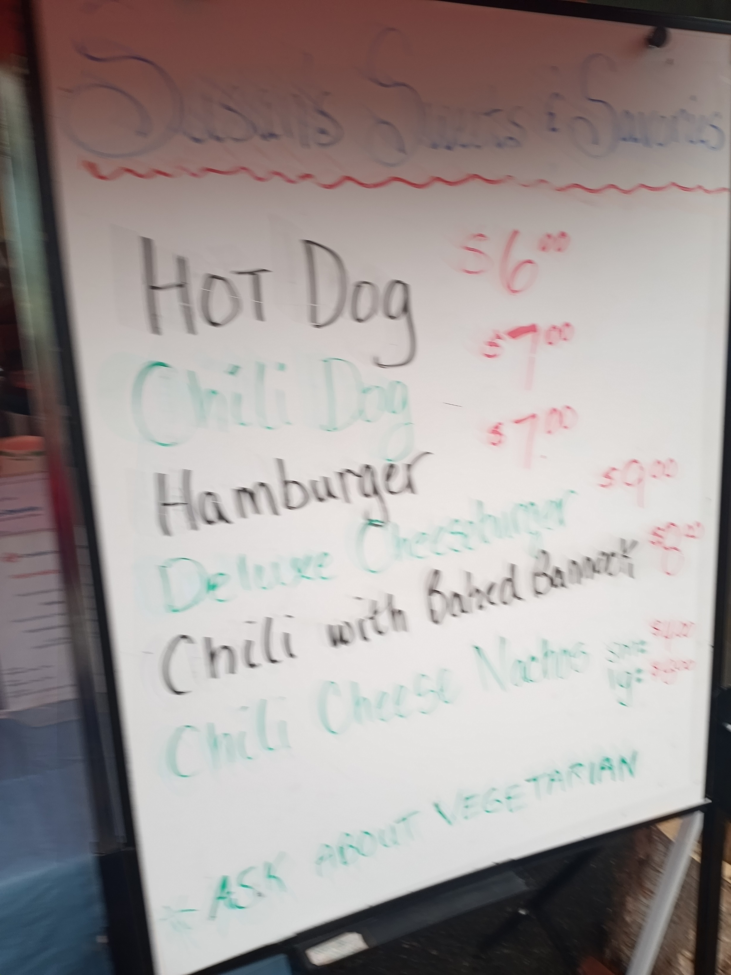
What does the vendor sell?
Hot dogs
Chili dog
Hamburger
Chili with Bannock
Deluxe cheese burger
Chili cheese nachos

Slide 3
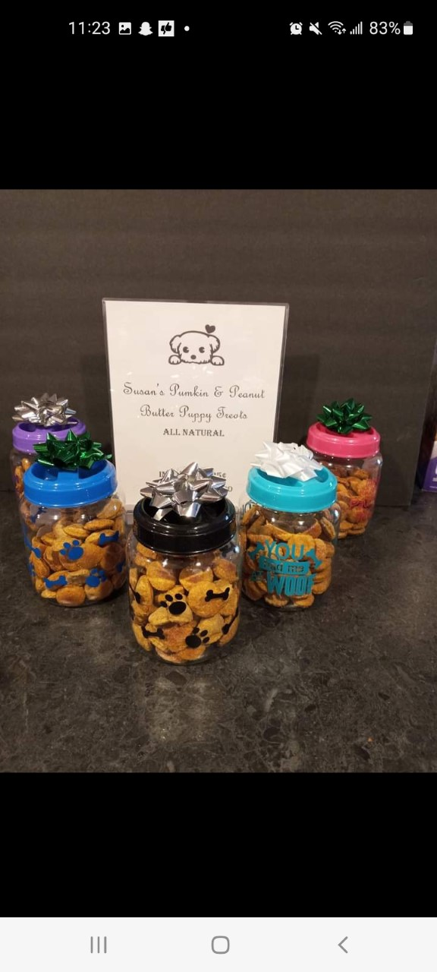
Why did they choose to grow, make or create these products?
They like working on their own schedule

Slide 4
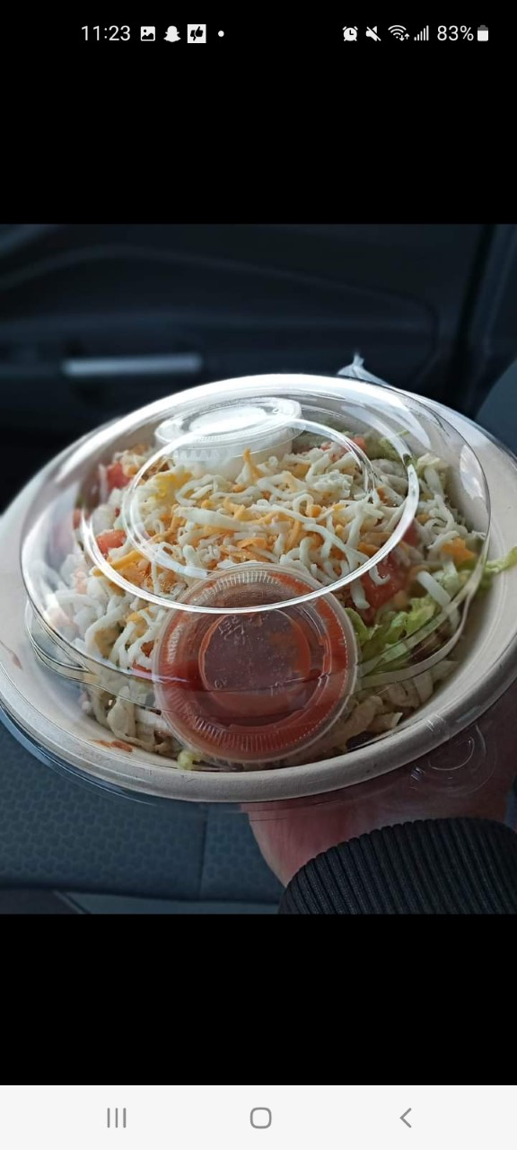
Do they do this business part-time or full-time? What other job(s) do they have?
This is there full time job

Slide 5
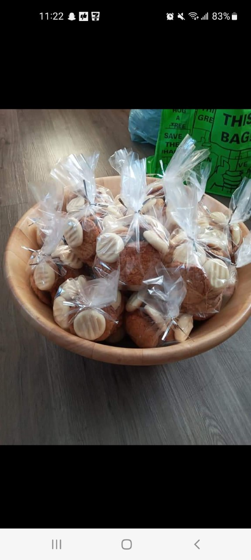
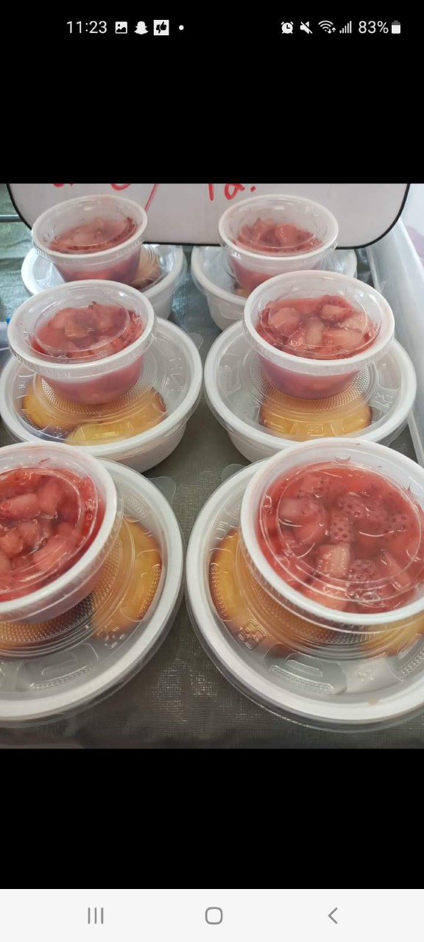
What do they like best about the market? What are the challenges?
Meeting new people
Doing different markets

Slide 6
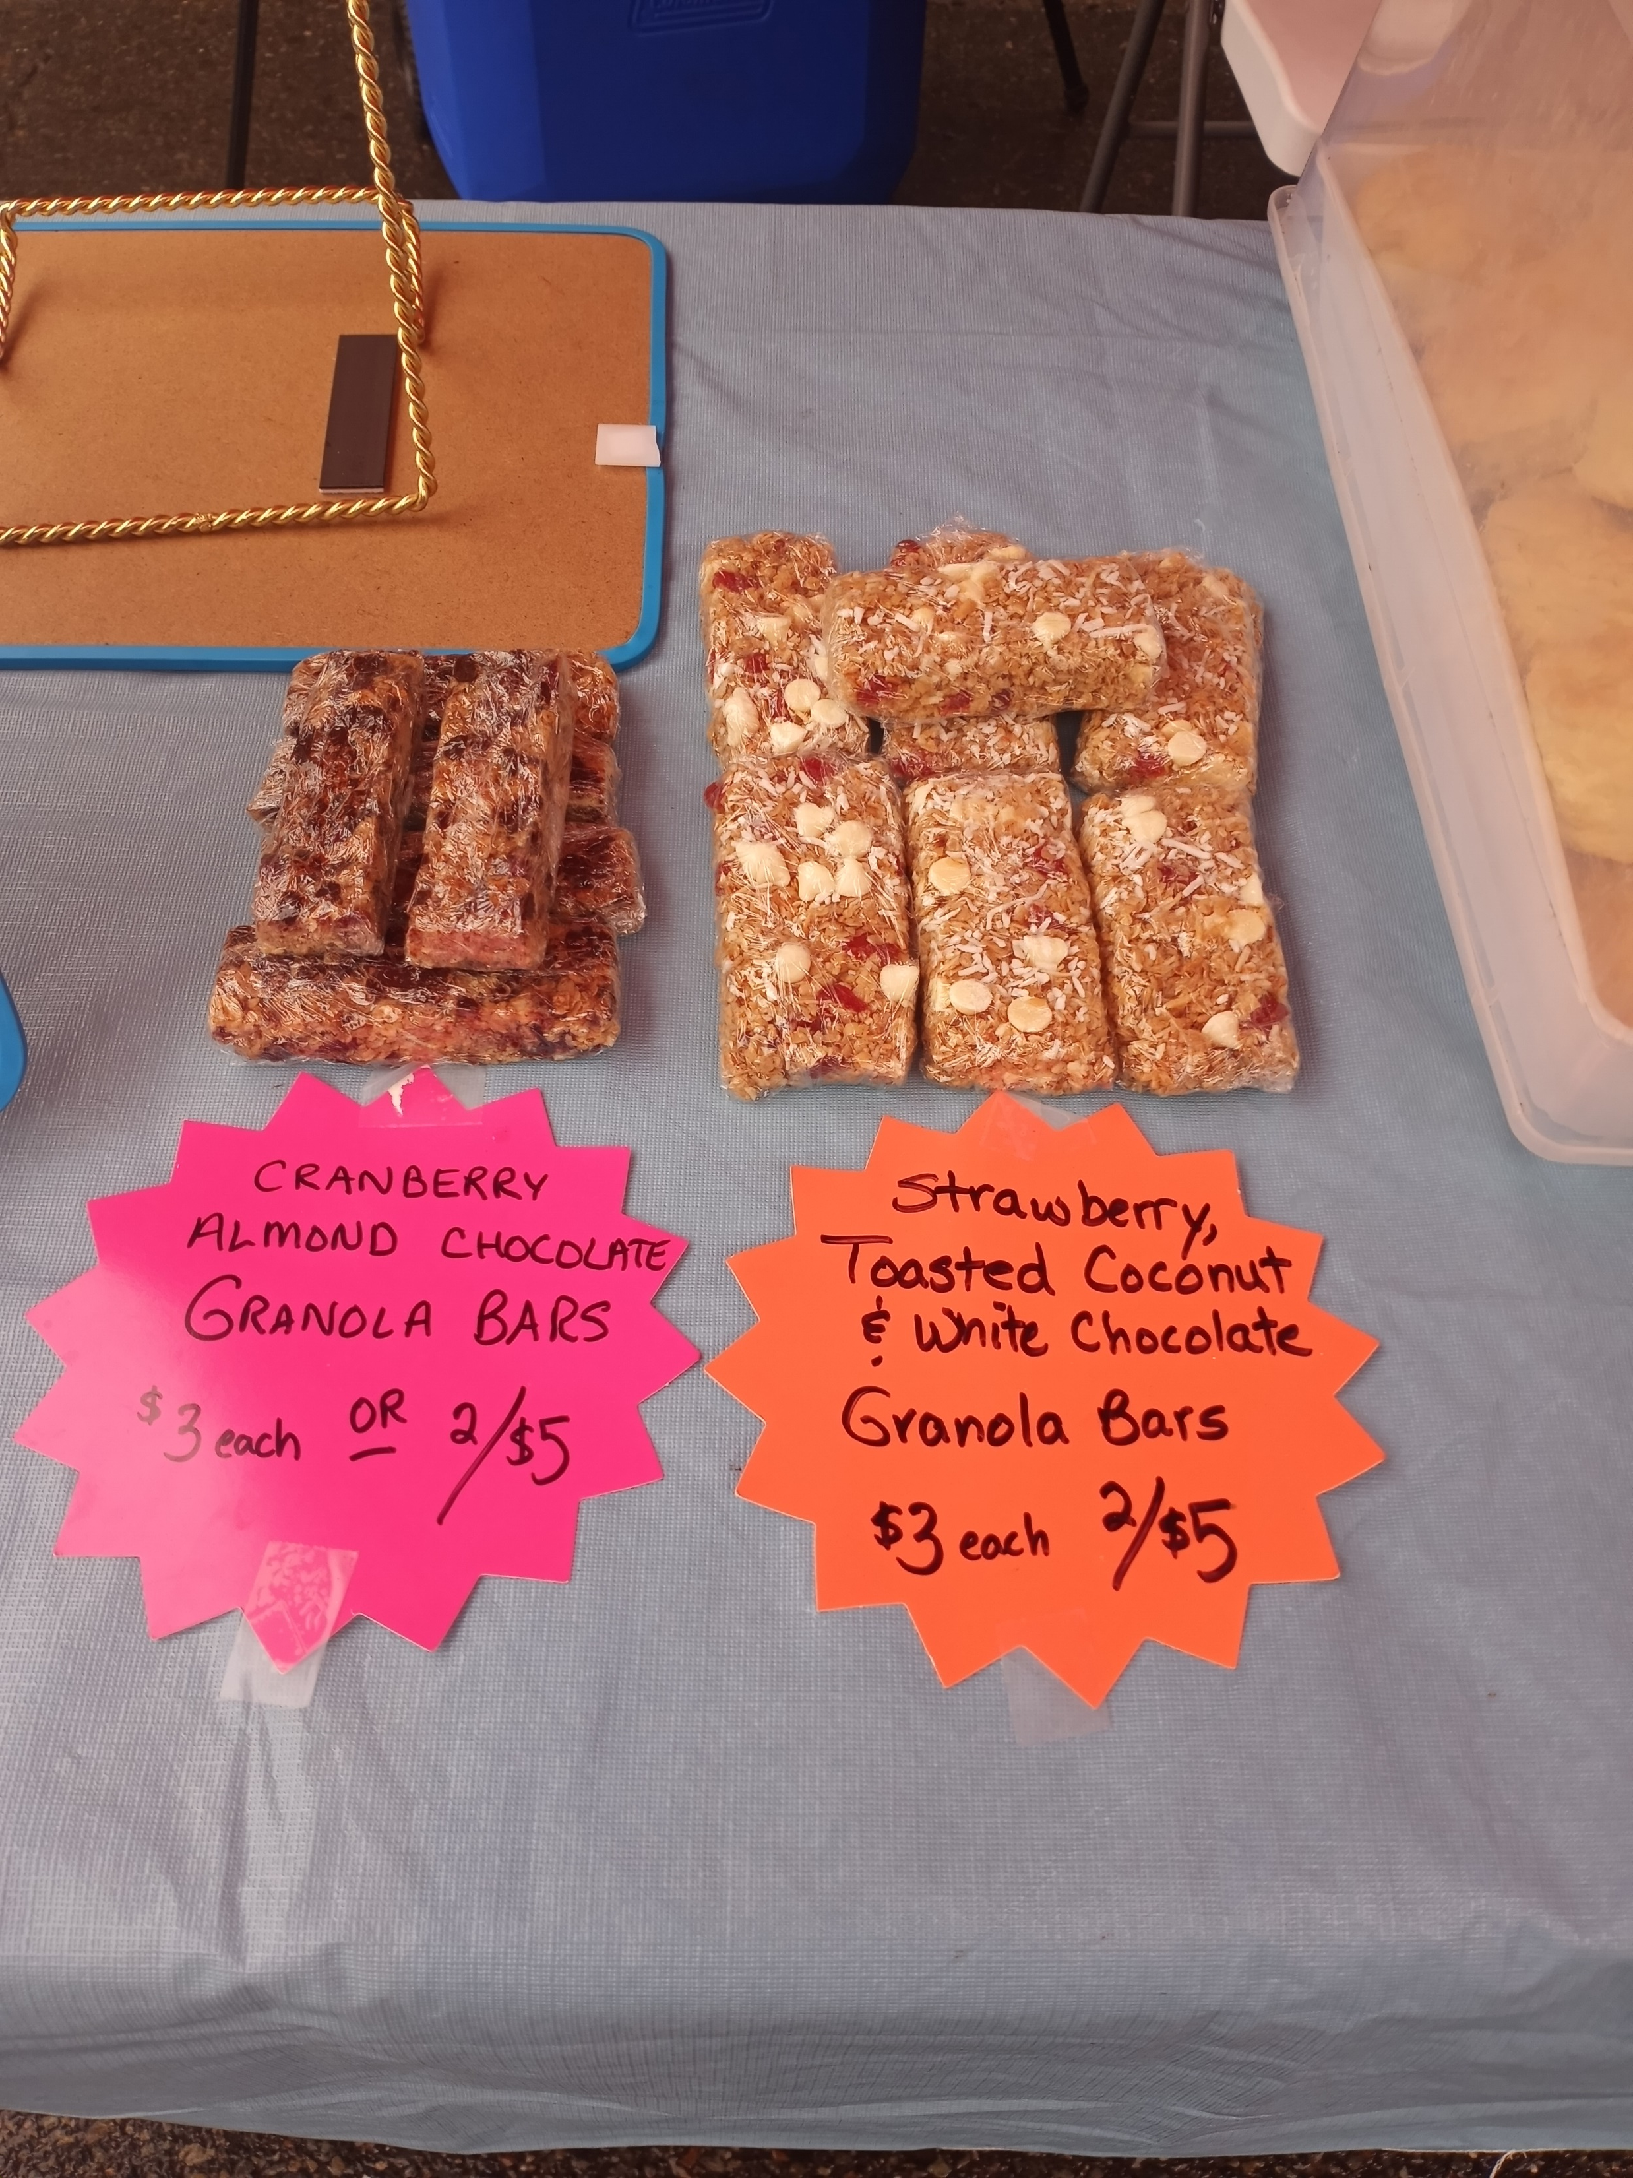
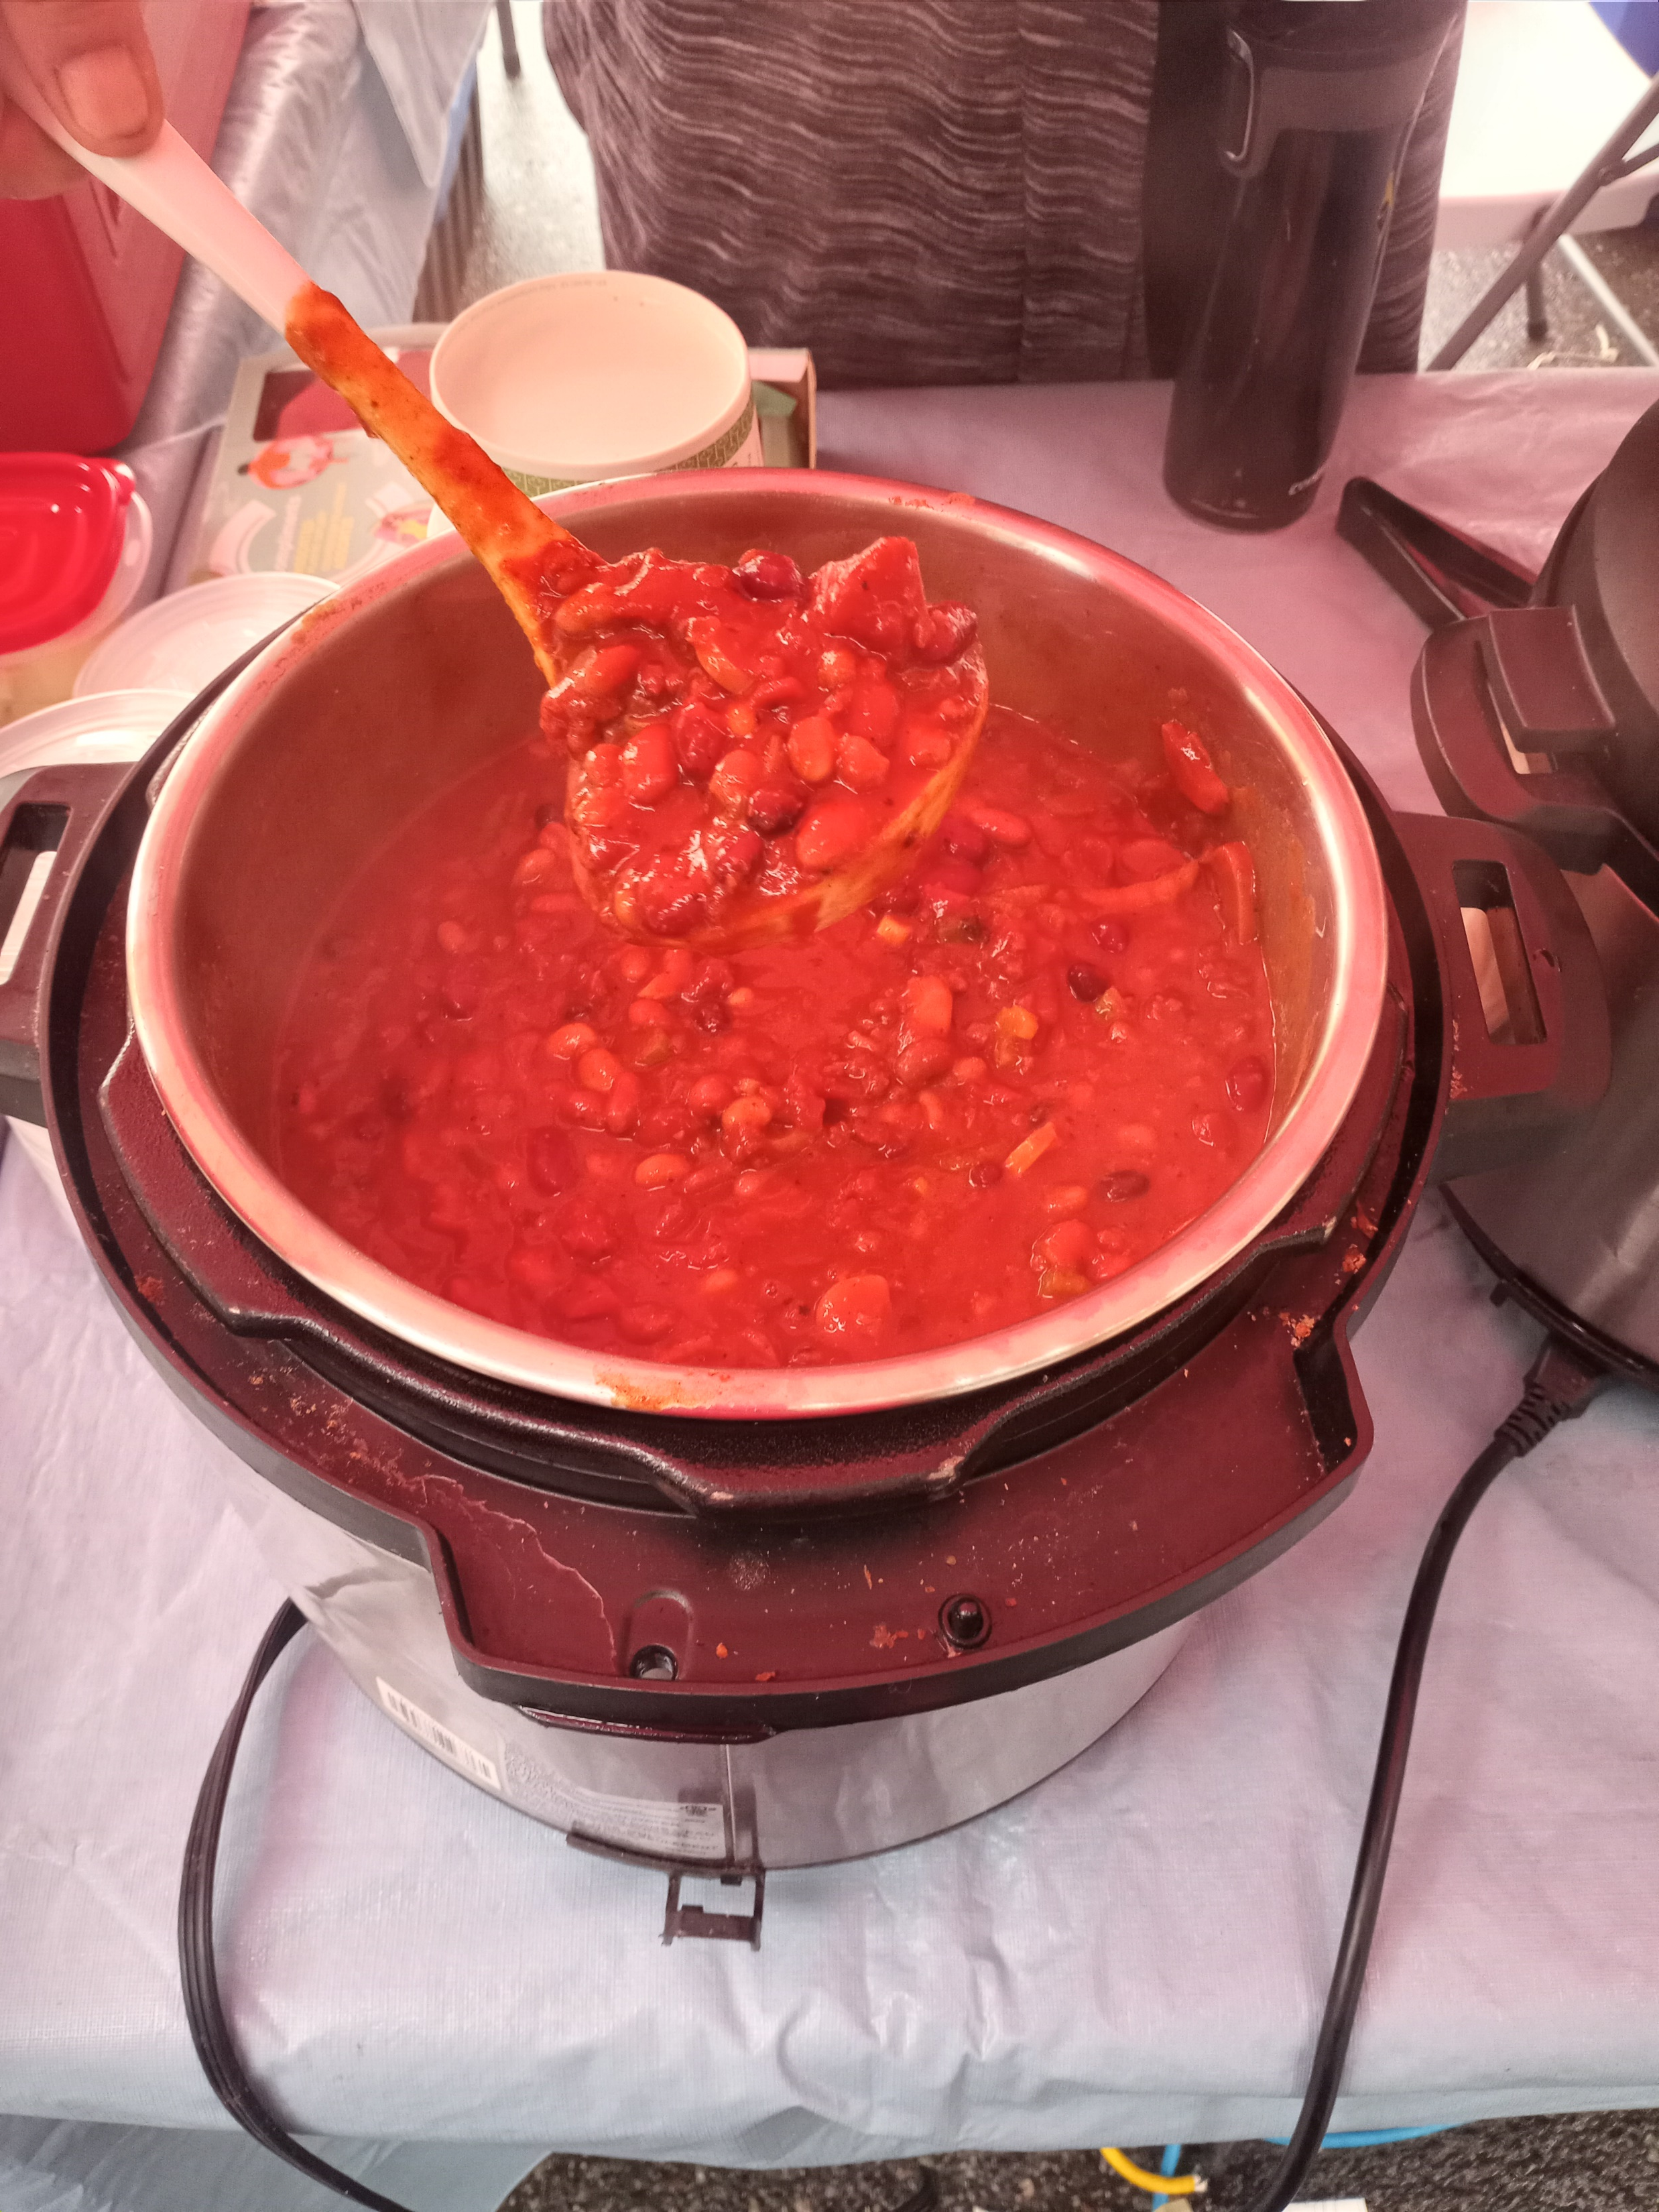
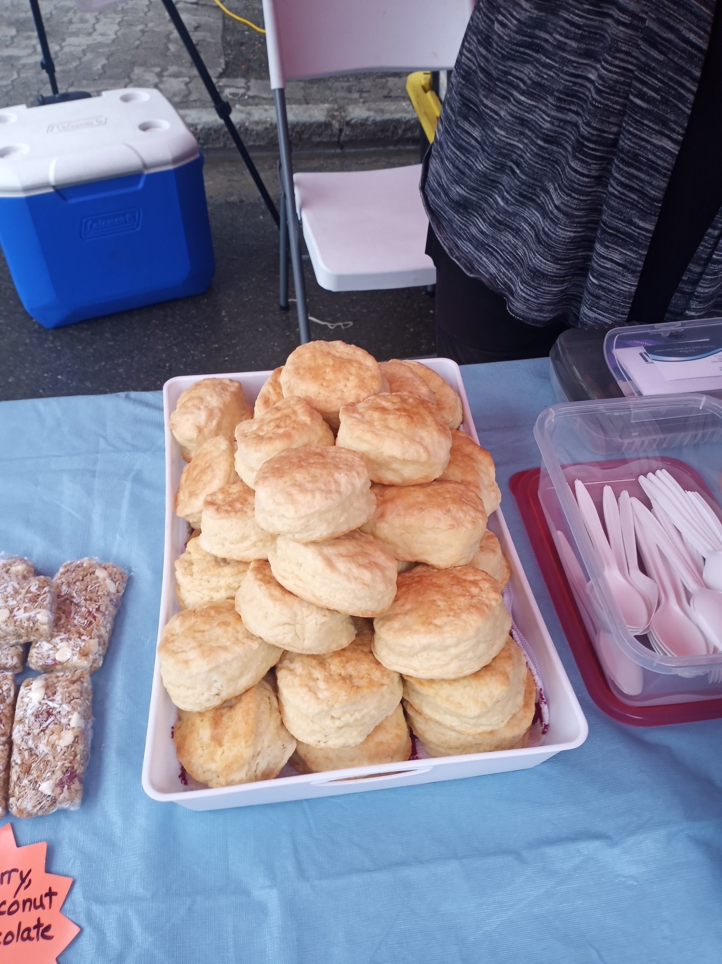
Would you recommend this vendor? Why?
I would recommend this vendor because she has a great attitude and amazing food………. Yum.

